Slide 1

React Routing
L Simhachalam

Slide 2
Topics
What is routing
React Router
Installation
Configuration
Navigation
URL Params
Nested Routing
Not Found Routes

Slide 3
What is routing
Routing means simply navigating from one URL to another URL without refreshing the application every time.
Routing is a process in which a user is directed to different pages based on their action or request.

Slide 4
React Router
It provides the core routing components and functions for the React Router applications.
Primary Components:
There are three primary categories of components in React Router
Routers, like <BrowserRouter> and <HashRouter>.
Route matchers, like <Routes> and <Route>
Navigation, like <Link> and <NavLink>

Slide 5
Installation
react-router-dom: It is used for web applications design.
react-router-native: It is used for mobile applications design.
$ npm install react-router-dom@6
or
$ npm install react-router-dom@latest

Slide 6
Configuration
Import { BrowserRouter,Routes,Route} from “react-router-dom”
<BrowserRouter>
<Routes>
<Route path="/" element={<Component />} />
</Routes>
</BrowserRouter>

Slide 7
Browser Router :
When we have big production-ready applications which serve backend,it is recommended to <Browserouter/>
Example:
http://localhost:3000/about
Hash Router:
When we have small client side applications which doesn’t need backend we can use <HashRouter>.When we use hashes in the URL bar browser doesn’t make server request.
Example:
http://localhost:3000/#/about

Slide 8
What is Route:
It is used to define and render component based on the specified path. It will accept components and render to define what should be rendered.
<Route path="/" element={<Component />} />

Slide 9
Navigation
Adding Navigation using Link,NavLink component
Link:
Uses to prop to navigate to specified path.
NavLink:
It will do the same like link but also having extra feature like active link or not.

Slide 10
URL Params
Path Params:
<Route path=“Dashboard/:name”/>
<Link to=‘/dashboard/simha’>
Query Params:
<Route path=“Dashboard/”/>
<Link to=‘/dashboard?name=simha’>

Slide 11
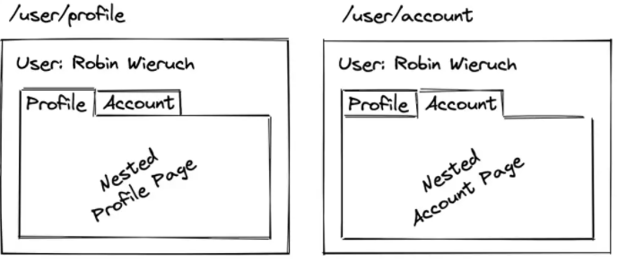
Nested Routing
allows one to exchange specific fragments of the view based on the current route.

Slide 12
Not Found Routes
When no other route matches the URL,You can render a “not found route using path =“*”
<Route path=“ * “ element={<NotFound/>} />

